Slide 1

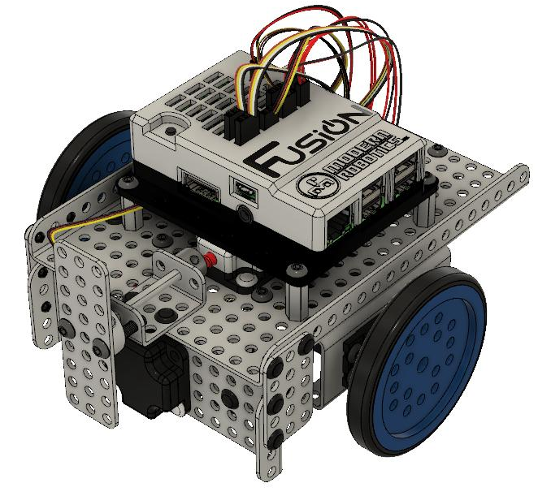

Mimio MyBot Base Kit
Building Instructions
Version 1.2
Boxlight Robotics Division

Slide 2
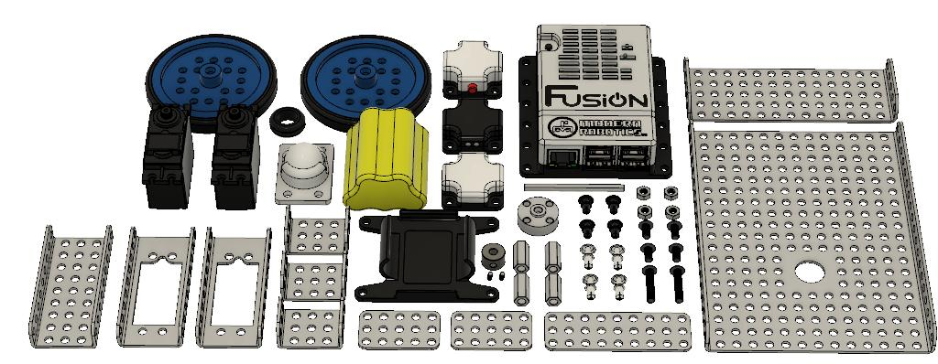
Copyright 2019, Boxlight Robotics Division. All Rights Reserved
No part of this document may be copied, published in print or shared online or otherwise publicly released without the express written consent of Boxlight Robotics Division.
Note: Specifications listed are subject to change without notice.

Slide 3
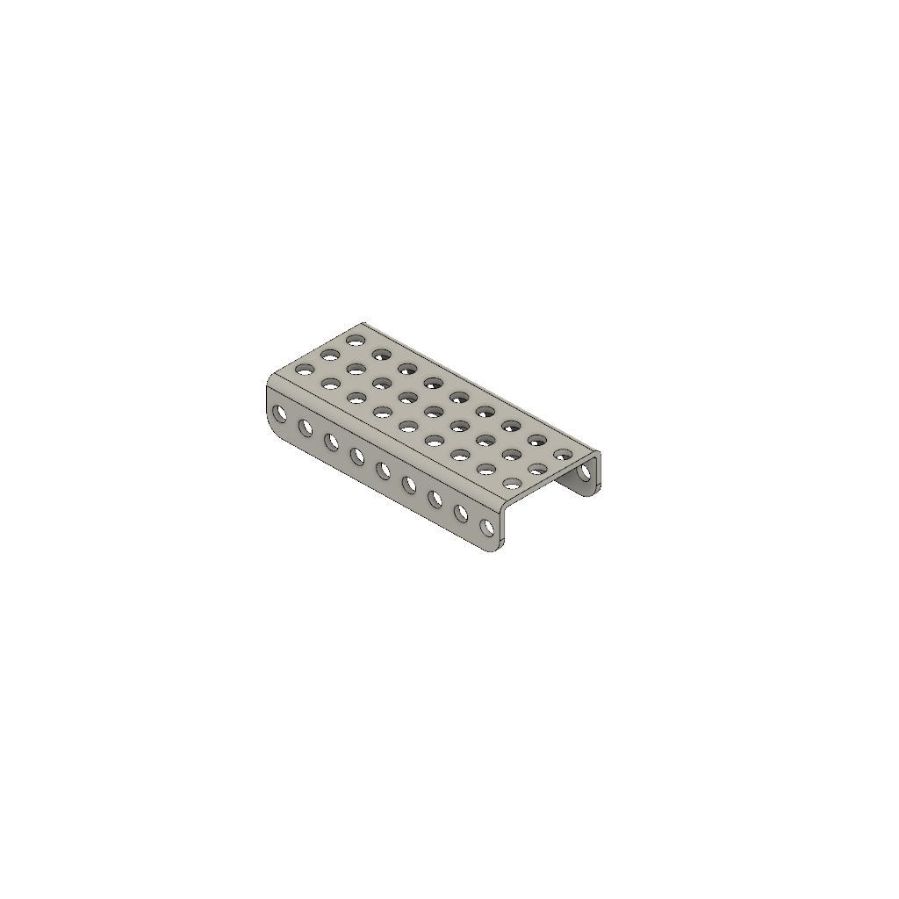
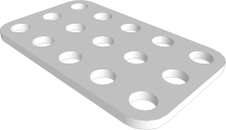
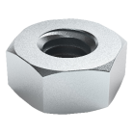
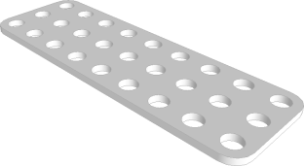
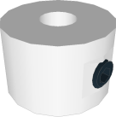
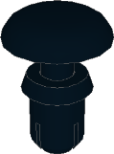
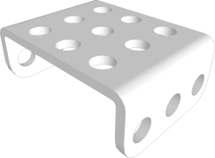
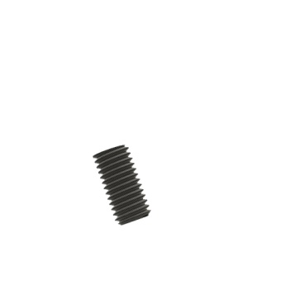
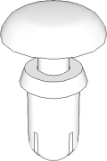
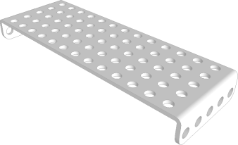
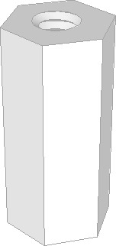
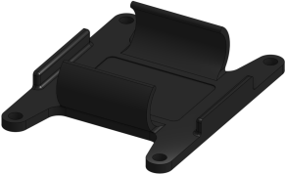
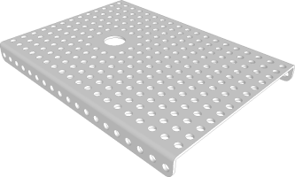
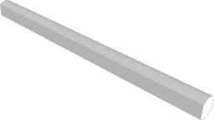
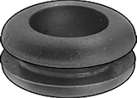
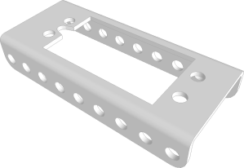
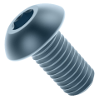
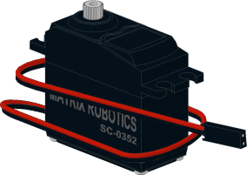
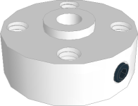
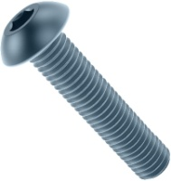
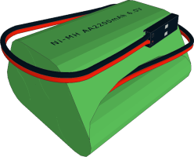
Illustrated List of Components
x2 04-0305 3x5 Gusset Plate | X1 06-0009 9 Hole C Shaped Beam | x20 11-4501 M4 Hex Nut
x1 04-0309 3x9 Gusset Plate | x1 08-0019 Axle Collar | x16 11-6001 Quick Connect Short
x3 05-0303 3x3 Flanged Plate | x2 (included with Collar and Hub) Axle Collar/Hub Set Screw | x10 11-6002 Quick Connect Medium
x1 05-0513 5x13 Flanged Plate | x4 09-0003 16mm Standoffs | x1 45-0300 Battery Pack Mount
x1 06-1319 13x19 Flanged Plate | x1 10-0052 52mm D-Shaft | x1 45-1007 Push-In Grommet
x2 07-0008 Servo/Motor Plate | x28 11-4108 M4 x 8mm Screw | x2 45-1010 DC Motor
x1 08-0007 Axle Hub | X2 11-4120 M4 x 20mm Screw | x1 45-1300 6V Battery Pack

Slide 4
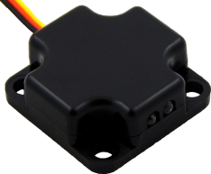
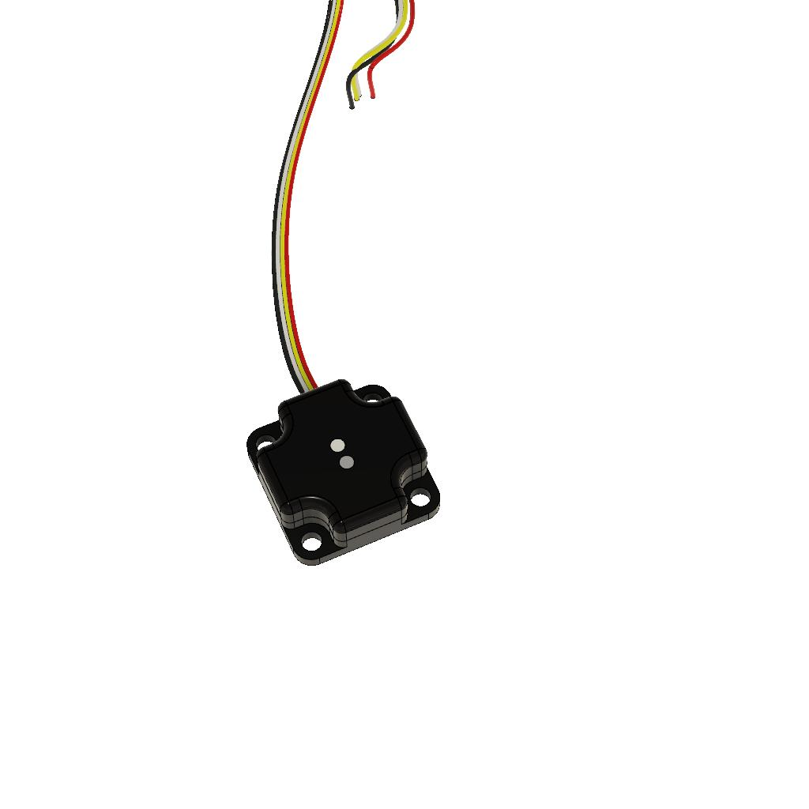
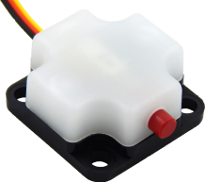
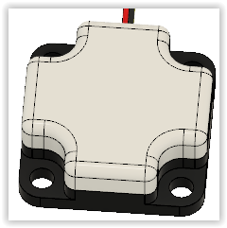
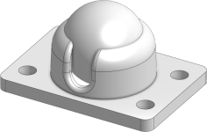
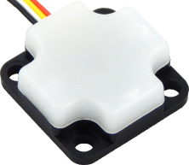
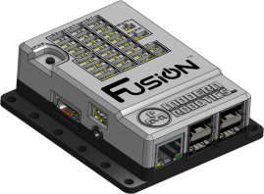
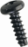

Illustrated List of Components
x1 45-2006 Optical Distance Sensor | X1 45-2018 Color Sensor
x1 45-2007 Touch Sensor | X1 45-2020 Magnet Sensor
x1 45-2100 19mm Ball Caster | x1 45-2005 Integrating Gyro
x1 52-2022 Fusion Controller | x2 45-1400 Wheel and Screw

Slide 5
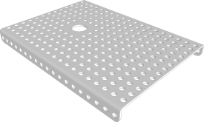
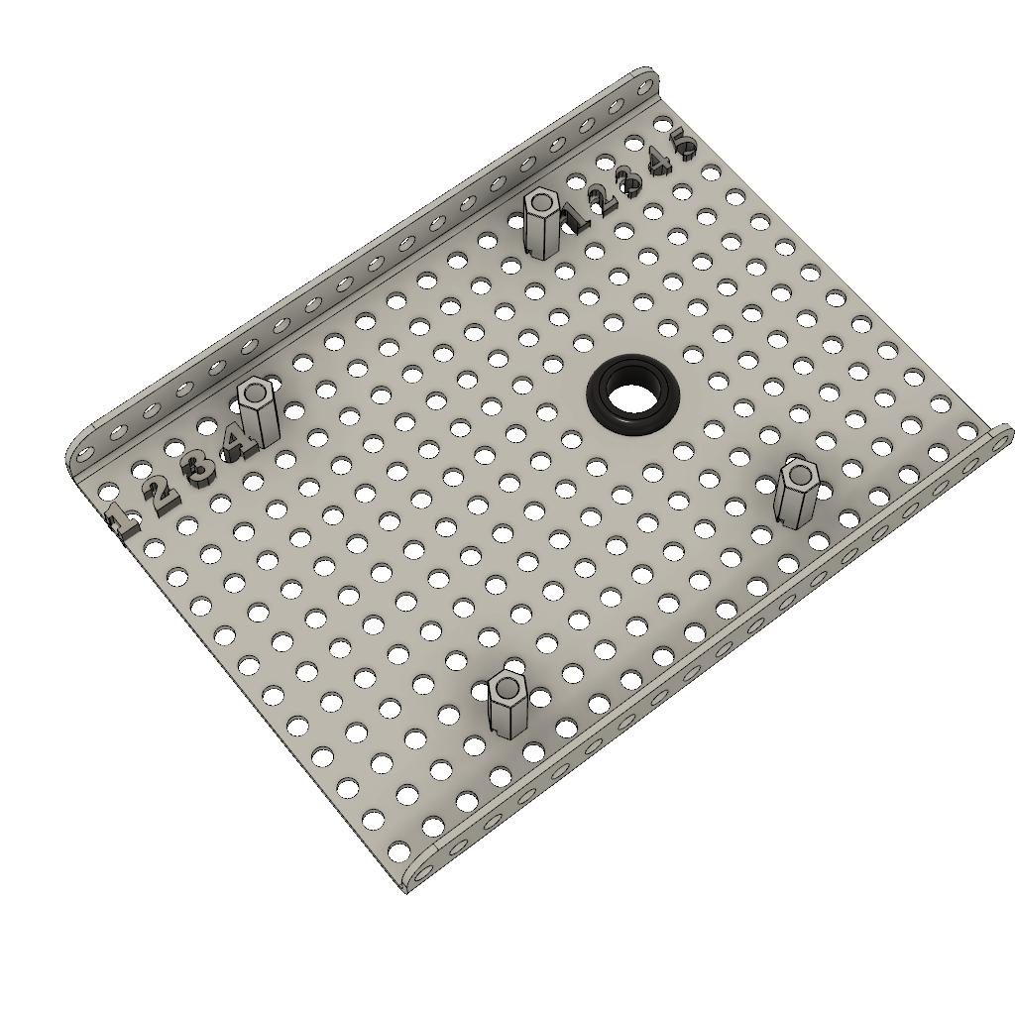
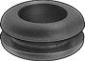


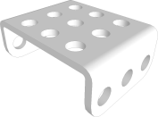
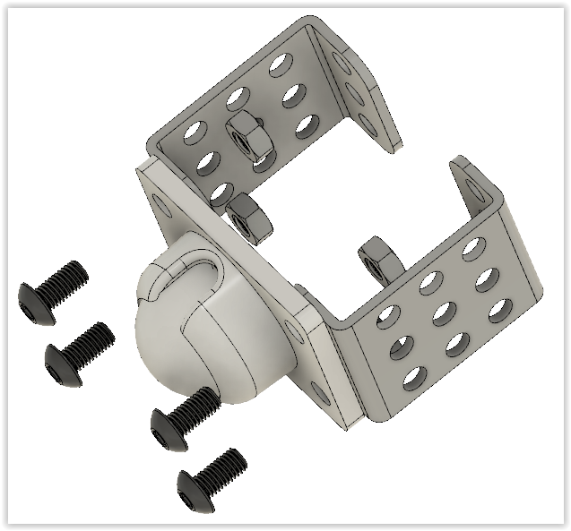
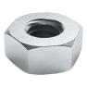
1
x1
x1
x4(8mm)
x4
2a
x1
x2
x4(8mm)
x4

Slide 6
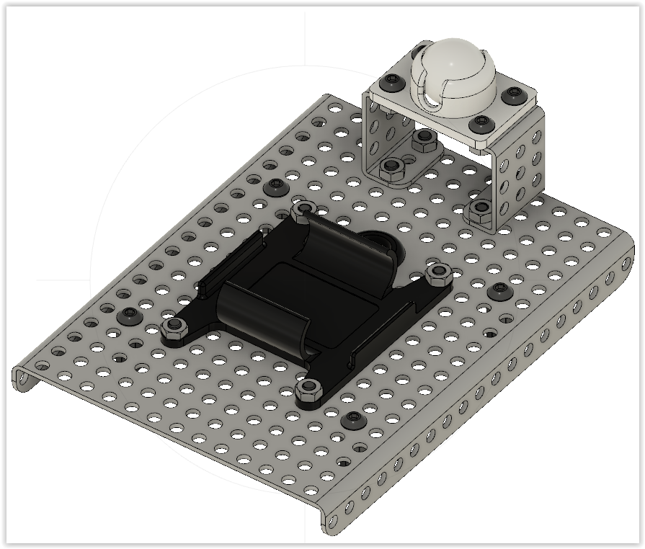

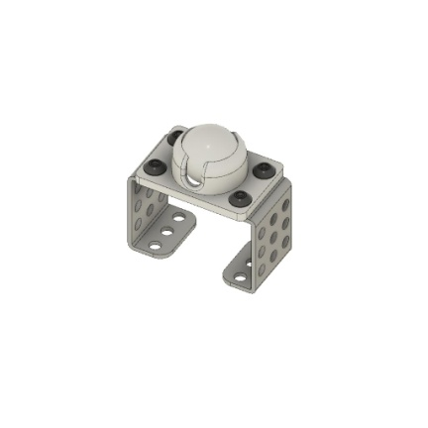


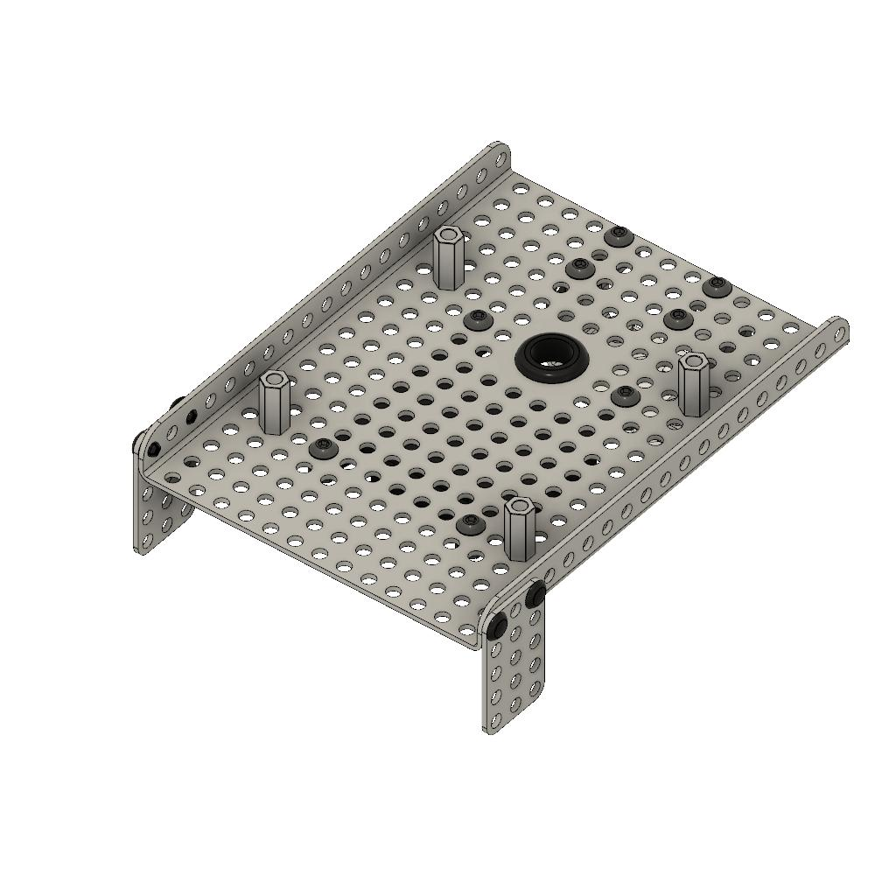
2b
x8(8mm)
x1
x1
x8
3
x2
x4

Slide 7
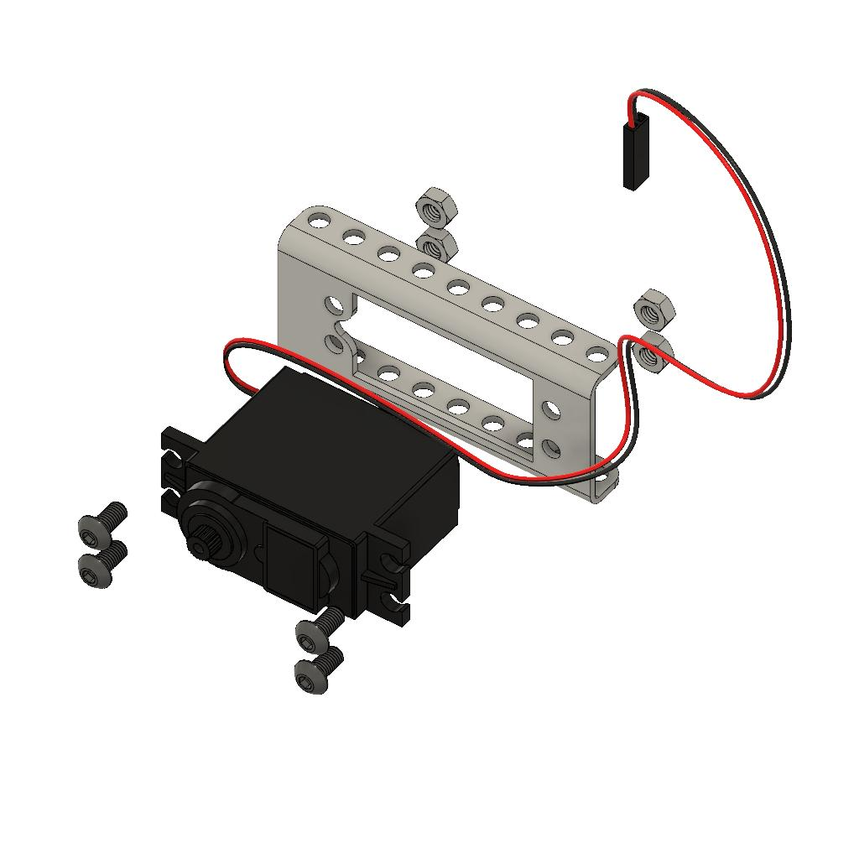



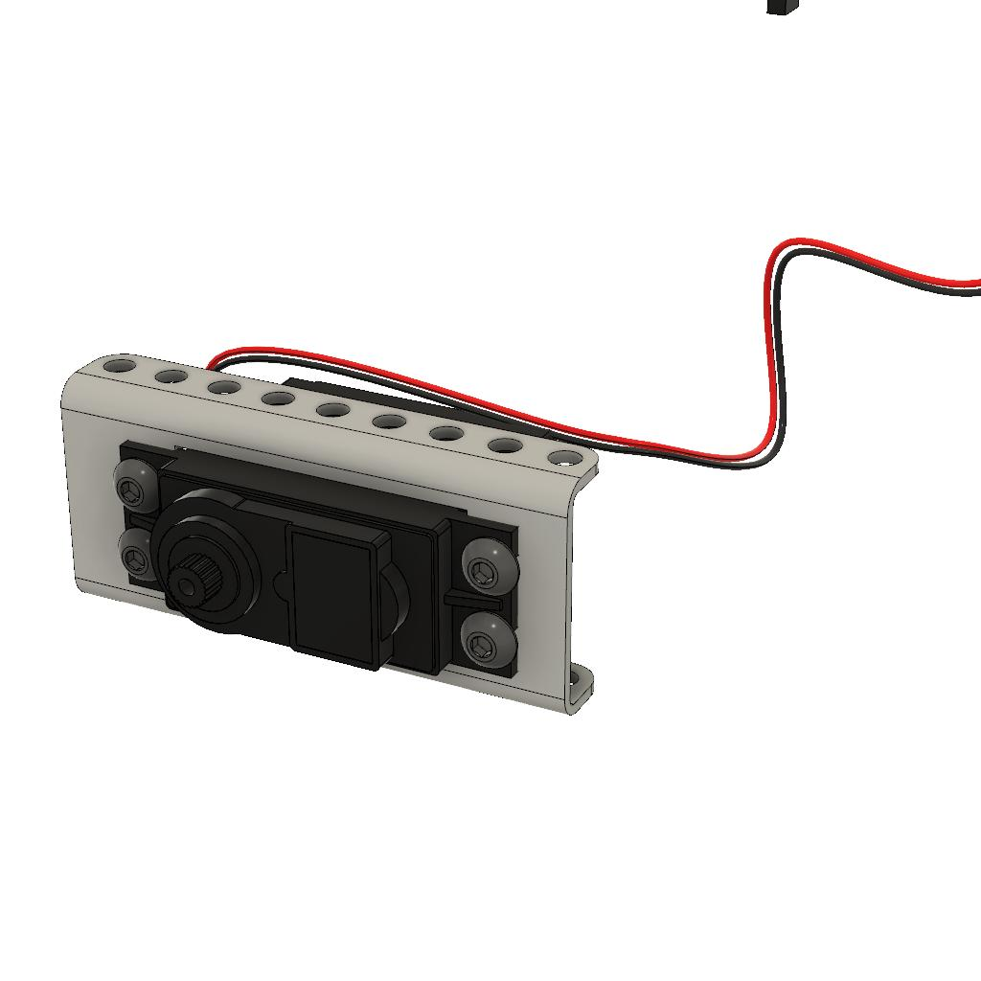
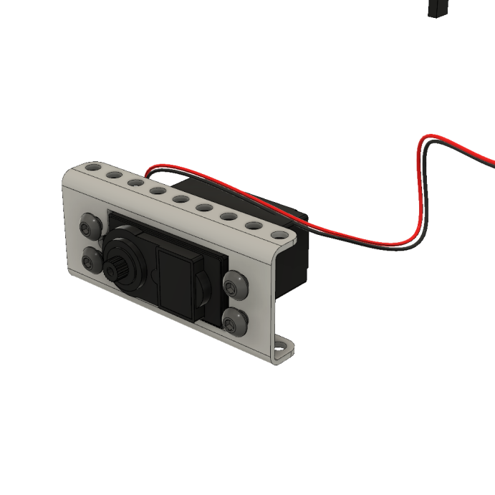
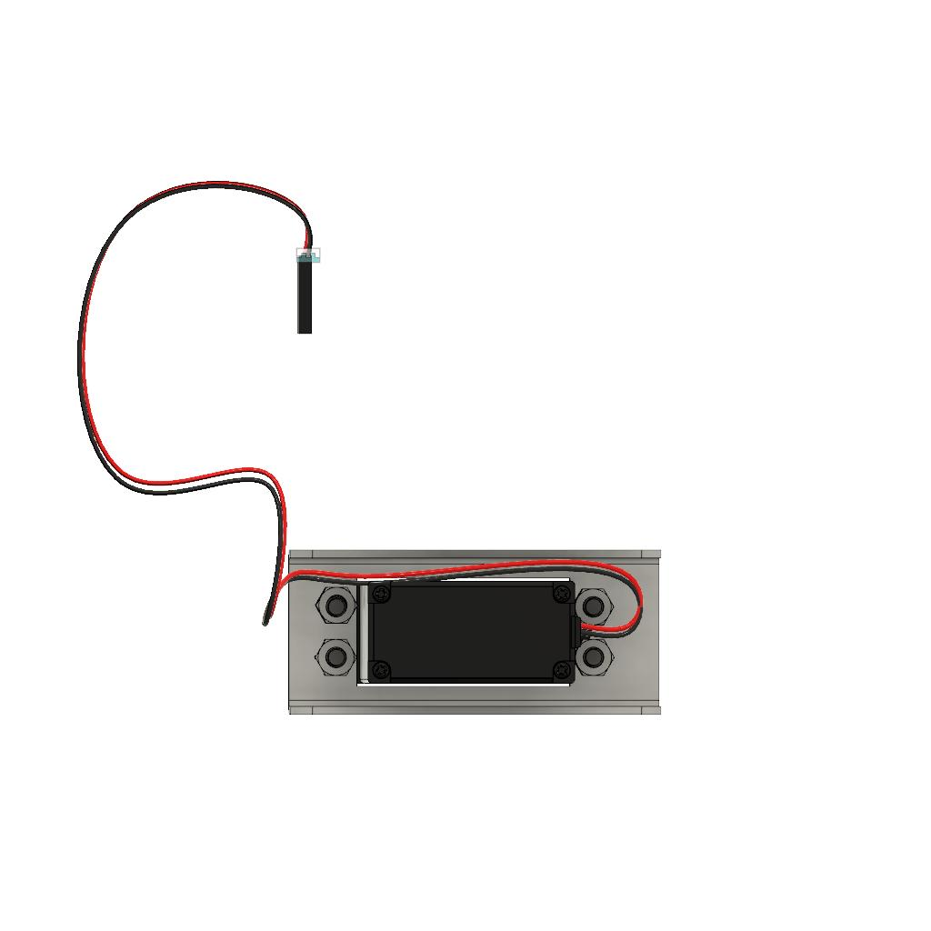

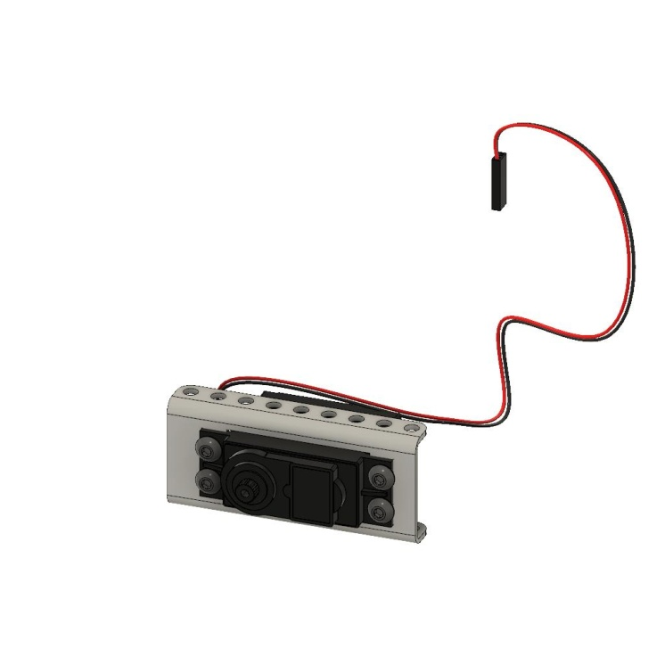
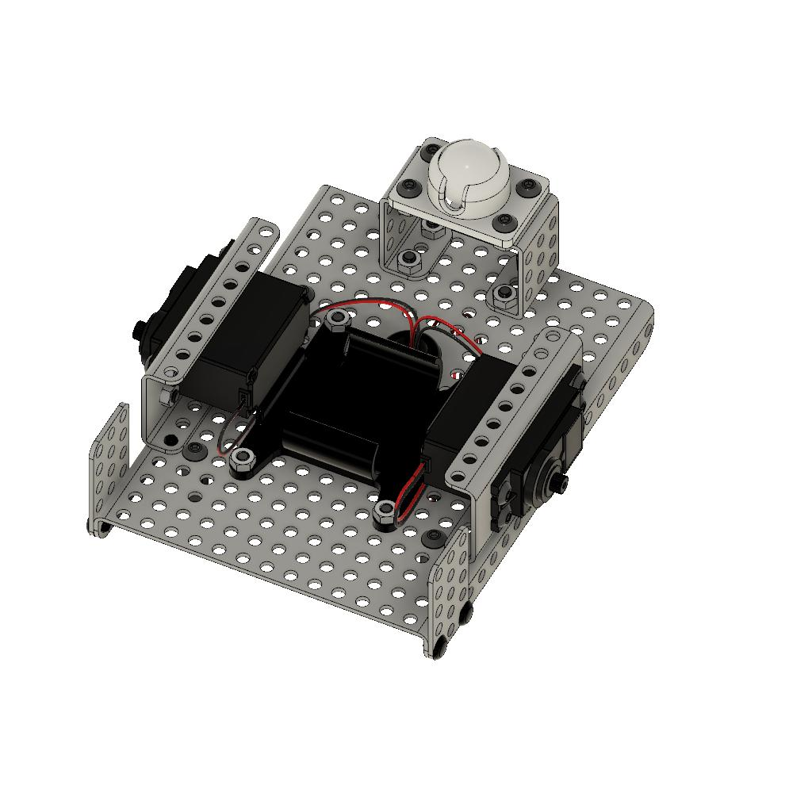
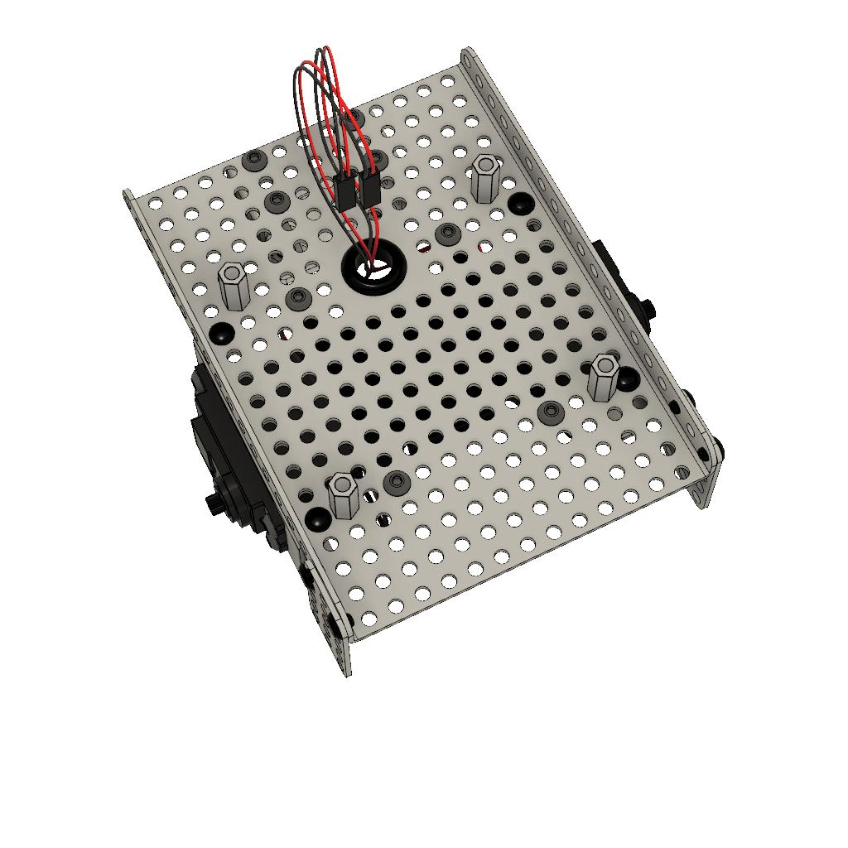
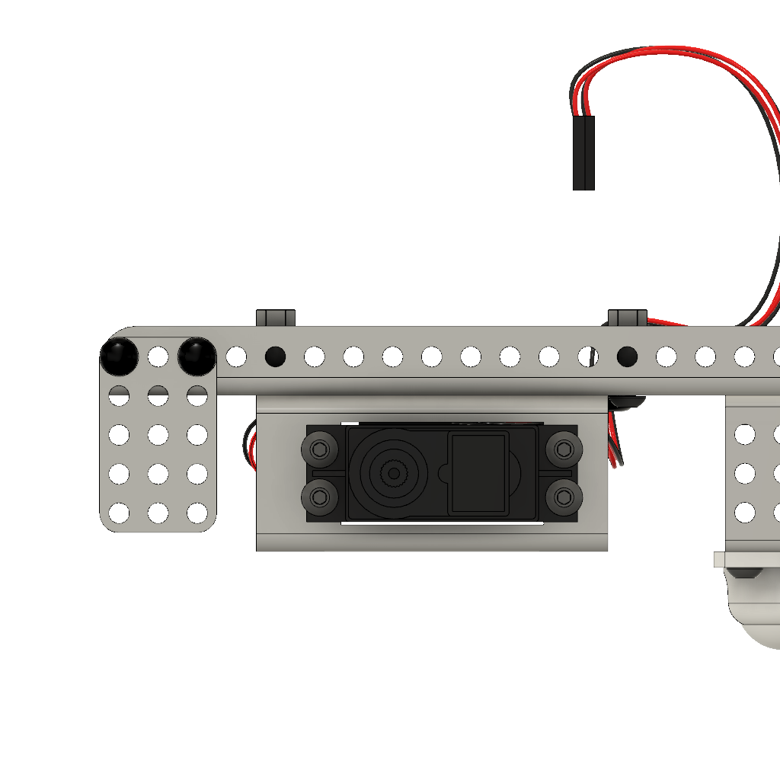
4a
x8(8mm)
x2
x8
x2
4b
x2
x4
M1
M0

Slide 8
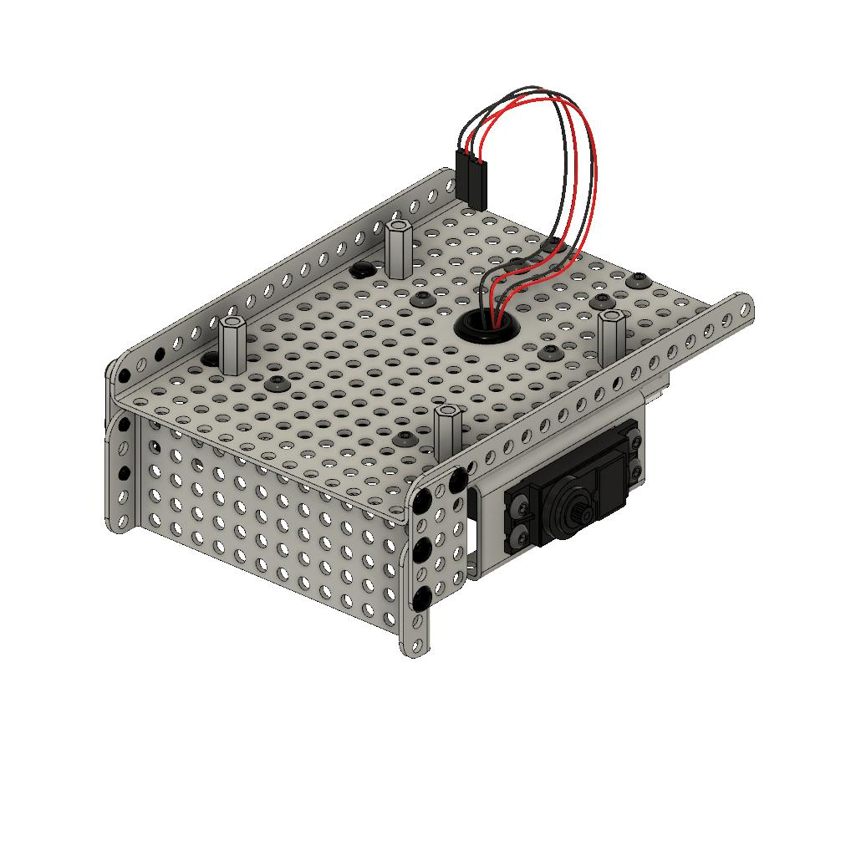


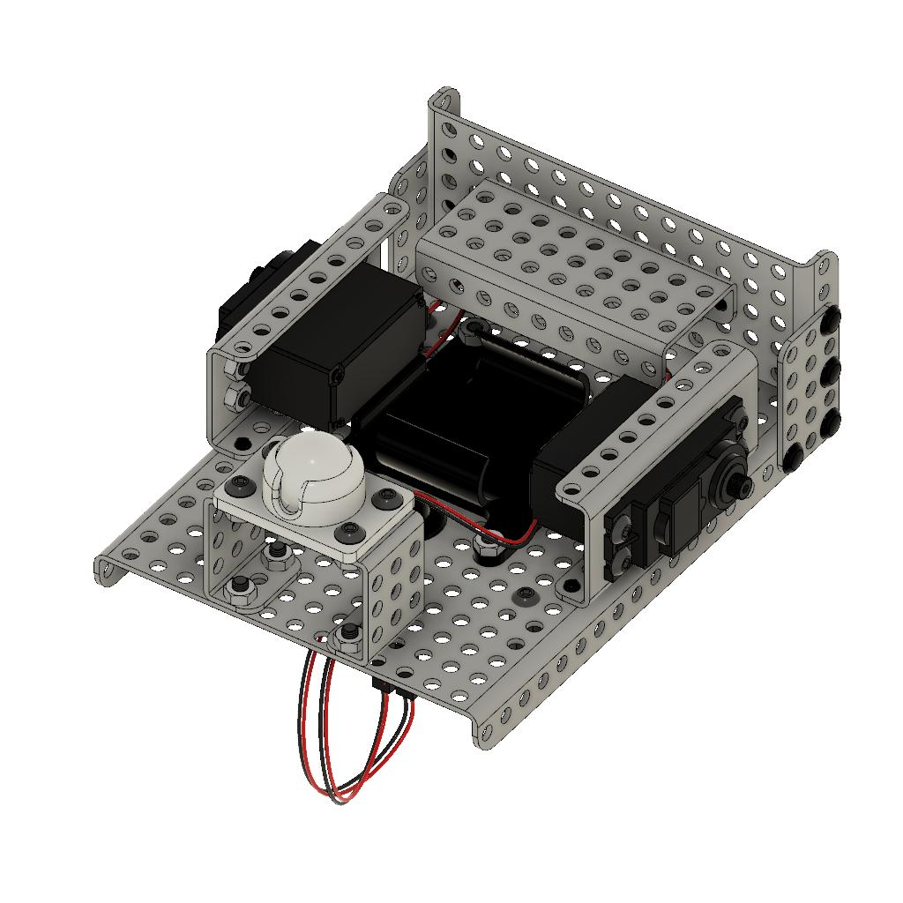

5
x1
x4
6
x1
x2

Slide 9




7
x2
x2
8
x1

Slide 10















9a
x1
x1
x1
x1
x1
x2
x2(20mm)
9b
x1
x2

Slide 11








10
x1
x1
(Integrating Gyro)
x4
11
x1
x1 (Magnetic Field Sensor)
x4

Slide 12





12
x1
x2
13
x1
x4(8mm)

Slide 13







Optical Distance Sensor | → | A0
Magnetic Field Sensor | → | D1
Touch Sensor | → | D0
Color Sensor | → | I2C
Integrating Gyro | → | I2C
Right Motor | → | M0
Left Motor | → | M1
Battery | → | BATT
M0
M1

